Slide 1
How to Learn Bioinformatics
Jagan L Bioinformatics Team Lead, Decode Age
Lecture 1: Introduction

Slide 2
Why Bioinformatics? Biology’s Growing Data
Sequencing costs have decreased drastically, making it possible for researchers to generate large amounts of sequencing data, leading to an exponential growth of biological databases worldwide.
This data was previously too expensive to generate, but now it is accessible to all researchers.
The amount of sequencing data stored in repositories like the Sequence Read Archive has doubled every year since 2011.
Advances in sequencing chemistry and algorithms have revolutionised genome assembly.
Lecture 1: Introduction
Bversity x Jagan L

Slide 3
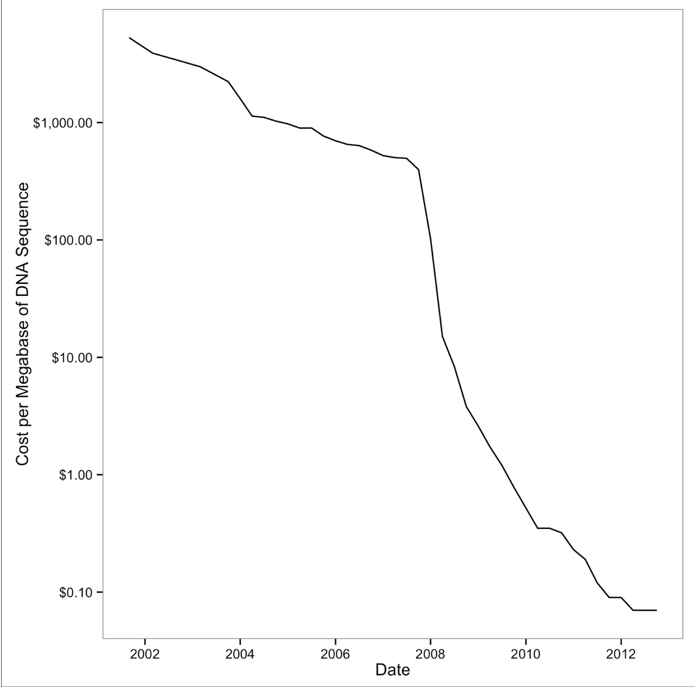
Drop of sequencing costs (note the y-axis is on a logarithmic scale); the sharp drop around 2008 was due to the introduction of next-generation sequencing data.
Bversity x Jagan L

Slide 4
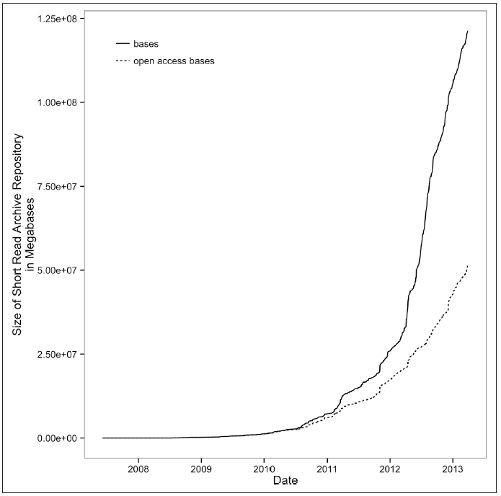
Exponential growth of the Short Read Archive; open access bases are SRA submissions available to the public
Bversity x Jagan L

Slide 5
Why learning Data Skill is important to Learn Bioinformatics
With the nature of biological data changing so rapidly, how are you supposed to learn bioinformatics?
With all of the tools out there and more continually being created, how is a biologist supposed to know whether a program will work appropriately on his/her organism’s data?
The solution is to approach bioinformatics as a bioinformatician does: try stuff, and assess the results.
So what are data skills?
They are the set of computational skills that give you the ability to quickly improvise a way of looking at complex datasets, using a well-known set of tools.
Lecture 1: Introduction
Bversity x Jagan L

Slide 6
New Challenges for Reproducible and Robust Research
The requisite of reproducibility is that we share our data and methods. In the pre- genomics era, this was much easier. Currently, the size of our data and the complexity of our analysis workflows make these goal especially difficult in genomics.
The complexity of bioinformatics analyses leads to susceptibility to errors and technical confounding.
Reproducibility is further complicated by the numerous processing steps involved in bioinformatics workflows and the reliance on specific software versions .Attention to reproducibility and robustness is crucial in genomics data analysis.
Lecture 1: Introduction
Bversity x Jagan L

Slide 7
Reproducible Research
The standard practice for in-silico reproducibility:
Do’s
Sharing code and data.
Provide details like software versions, data versions, and metadata is also crucial to ensure reproducibility.
Don'ts:
Poor project planning.
Poor documentation can lead to errors and irreproducibility, so striving for maximal reproducibility can also increase the robustness of a project.
Lecture 1: Introduction
Bversity x Jagan L

Slide 8
Robust Research (the Golden Rule of Bioinformatics)
In wet lab biology, failed experiments are easily noticeable, but in scientific computing, errors can be silent and produce incorrect output.
Genomics data is high-dimensional and produces intermediate output that is hard to visualize or inspect fully.
Bioinformatics tools may not work well on all organisms, and parameters need to be carefully tuned.
Adopting a cautious attitude and checking input data, intermediate results, and testing programs is crucial to ensure the quality of bioinformatics analyses.
Lecture 1: Introduction
Bversity x Jagan L

Slide 9
Recommendations for Robust Research
Writing code:
Code should be readable and easy to understand
Code should be modular, reusable, and broken down into small, contained components.
Commenting code and following a style guide are simple ways to increase code readability.
In contrast to code, data should be formatted in a way that facilitates computer readability. Human-readable data can be difficult to process by computers and often requires a significant amount of cleaning and tidying.
Suggestion: Google has public style guides for many languages that can serve as excellent templates.
Lecture 1: Introduction
Bversity x Jagan L

Slide 10
2) Let Your Computer Do the Work For You
Repetitive task: Take advantage of the benefits of automation, it's important to organize projects, data, and code in a way that facilitates automation. Simple habits like consistent file naming conventions that are easily understood by computers can greatly facilitate automation and make work much easier.
3) Test Code, or Better Yet, Let Code Test Code
Unit testing: which is widely used in the software industry to ensure code quality and prevent bugs, is not commonly used in scientific coding despite the fact that scientific code is more prone to bugs.
This is known as the paradox of scientific coding, as testing should be utilized more in scientific coding, but it is often neglected. This is especially unfortunate since many scientific conclusions are based on large amounts of code.
Lecture 1: Introduction
Bversity x Jagan L

Slide 11
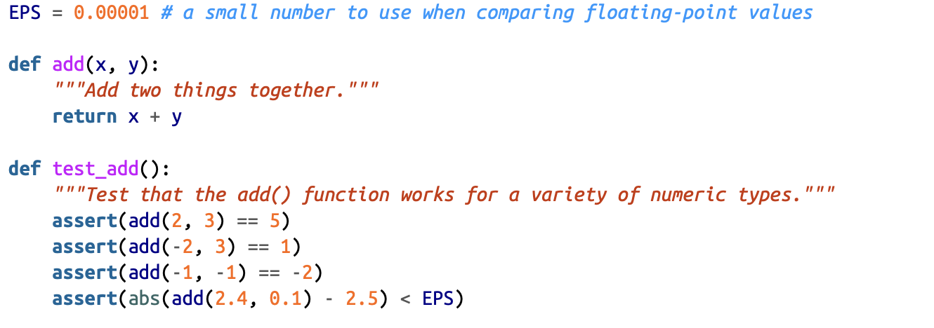
A sensible strategy is to consider three important variables each time you write a bit of code:
How many times is this code called by other code?
If this code were wrong, how detrimental to the final results would it be?
How noticeable would an error be if one occurred?
Lecture 1: Introduction
Bversity x Jagan L

Slide 12
4) Treat Data as Read-Only
Modifying data can make it easy to lose track of how the data has been changed.
Unlike a workflow with input and output files at each step, modifying a file in place provides no indication of what has been done to it. Without a backup copy of the original data, these changes are essentially irreproducible.
5) Spend Time Developing Frequently Used Scripts into Tools
Turn your scripts into tools. Unlike scripts, tools are designed to be run repeatedly and are well-documented, versioned, and have clear command-line arguments. They are also typically kept in a shared version control repository, making them easy to access and modify by other researchers in your lab or elsewhere.
Lecture 1: Introduction
Bversity x Jagan L

Slide 13
6) Use Code as Documentation
Maintaining good documentation is crucial for reproducibility in bioinformatics. While releasing code and data is necessary, documenting each step of analysis in detail is equally important. Here are some key points to consider:
Adopt the practice of documenting each analysis step in plain-text README files, just like a detailed lab notebook.
This documentation should include information on where files are located, their origin, and their contents. This can be stored alongside the project's code and data to aid collaborators in understanding what has been done.
It's important to include all input parameters for each program executed, as well as the program versions and how they were run. This ensures that analyses can be reproduced exactly.
Detailed documentation also allows you to track the evolution of your analysis over time, making it easier to identify potential issues or errors.
Finally, remember that documentation is not just for your own benefit. Sharing your documentation with others in the field can improve transparency and facilitate collaboration.
Lecture 1: Introduction
Bversity x Jagan L

Slide 14
Basic Linux Commands
ls: Lists files and directories.
mkdir: Creates a new directory.
cd: Changes the current directory.
pwd: Shows the current directory path.
touch: Creates an empty file or updates a file's timestamp.
echo: Prints text or variables.
cd ..: Moves up one directory level.
mv: Moves or renames files and directories.
rm: Deletes files or directories.
cp: Copies files or directories.
cat: Displays file contents.
find: Searches for files and directories.
grep: Searches for text patterns in files.
clear: Clears the terminal screen.
df: Shows disk space usage.
du: Shows space used by files and directories.
Lecture 1: Introduction
Bversity x Jagan L

Slide 15
Unix Shell
Jagan L Bioinformatics Team Lead, Decode Age
Lecture 2: Unix Shell

Slide 16
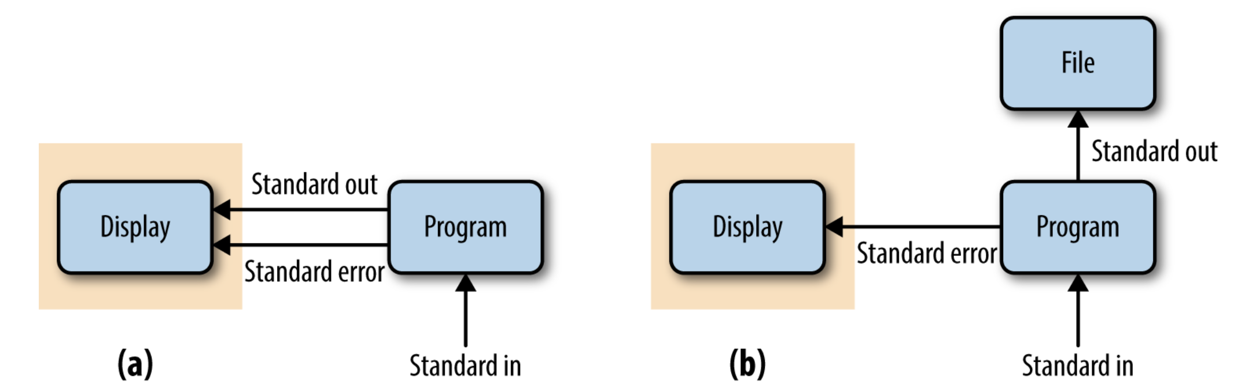
Streams and Redirection
Unredirected standard output, standard error, and standard input (the gray box is what is printed to a user’s terminal);
Standard output redirected to a file
Lecture 2: Unix Shell
Bversity x Jagan L

Slide 17
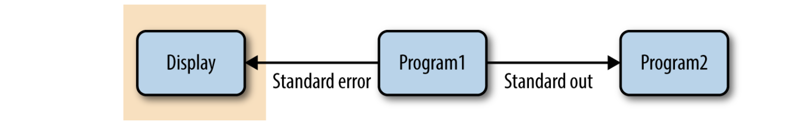
Unix Pipe
Unix pipes are similar to the redirect operators we saw earlier, except rather than redirecting a program’s standard output stream to a file, pipes redirect it to another program’s standard input. Only standard output is piped to the next command; standard error still is printed to your terminal screen
Piping standard output from program1 to program2; standard error is still printed to the user’s terminal
Example: $ program1 input.txt | tee intermediate-file.txt | program2 > results.txt
Lecture 2: Unix Shell
Bversity x Jagan L

Slide 18
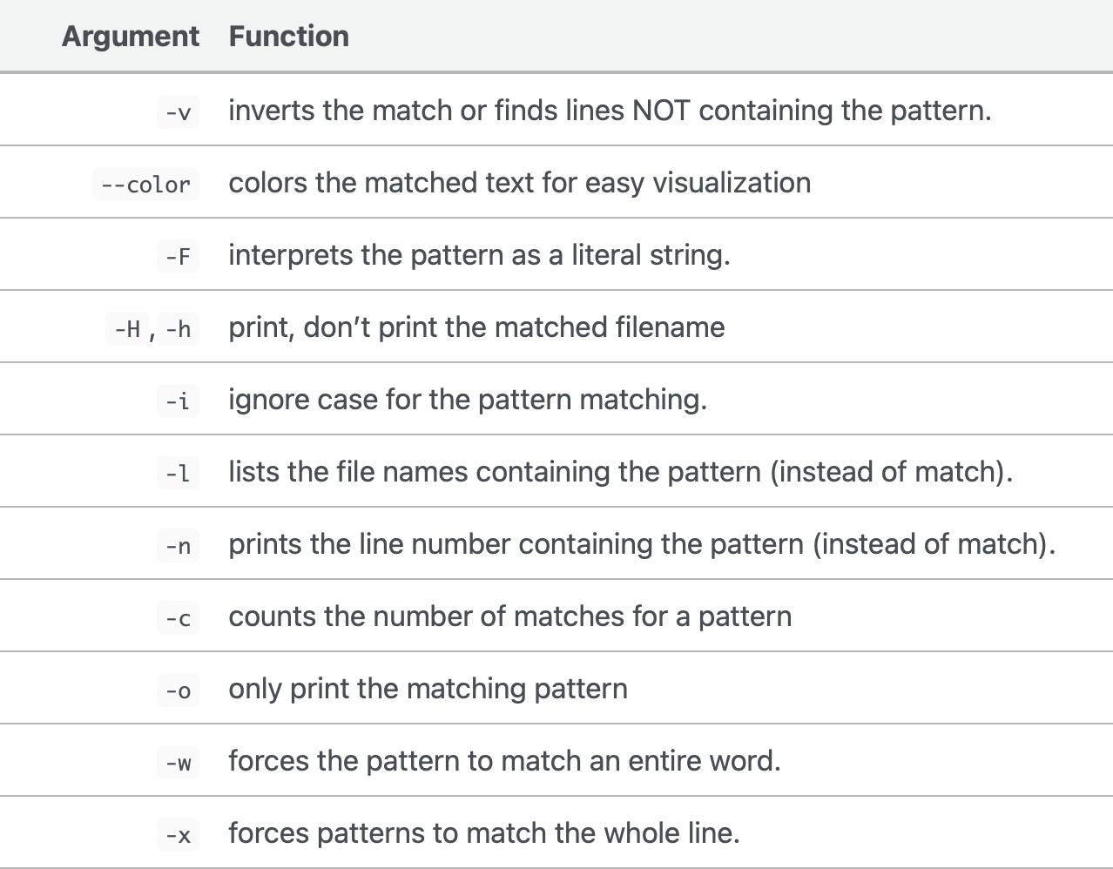
grep
grep (globally search a regular expression and print) is one of the most useful commands in UNIX and it is commonly used to filter a file/input, line by line, against a pattern eg., to print each line of a file which contains a match for pattern.
grep PATTERN FILENAME
Counting sequences: grep -c ">" FILENAME
Count a word: grep -o "PATTERN" FILENAME Search a motif: grep --color "PATTERN" FILENAME Finding patterns that DOES NOT match: grep -i "transcription factor" FILENAME
Finding blank lines
grep "^$" FILENAME
Lecture 2: Unix Shell
Bversity x Jagan L

Slide 19
Git for Scientist
Jagan L Bioinformatics Team Lead, Decode Age
Lecture 3: Git for scientists

Slide 20
Why Git Is Necessary in Bioinformatics Projects
Git Allows You to Keep Snapshots of Your Project
Version control systems like Git allow you to take snapshots (called commits) of your project at specific points during its development. This is incredibly useful because it enables you to restore files and rewind to a past version of your project's state if anything goes wrong.
One of the most frustrating types of bugs in any omics analysis is software regression, where a piece of code that was once working stops working or gives different results.
Git allows you to view every commit, when it was made, what has changed across commits, and even compare the difference between any two commits. This makes it easier to manage your project's development and keep track of changes
Lecture 3: Git for scientists
Bversity x Jagan L

Slide 21
2) Git Helps You Keep Track of Important Changes to Code
Tracking changes in software is crucial for scientific computing. Git simplifies this process by allowing you to track changes and download new versions of code easily. It also helps to avoid issues caused by bugs in earlier versions, which could lead to incorrect results. Git repositories hosted on the web by services like GitHub and Bitbucket facilitate code sharing and collaboration across labs.
3) Git Helps Keep Software Organised and Available After People Leave
Disorganised software tools and scripts can create inconvenience and delay future research in a lab, especially when the main developer leaves. Git can help maintain continuity in work and preserve a full record of a project's history. By centralising an entire project into a repository, Git keeps it organised and stores every committed change. This means that the entire history of a project is available, even if the main developer is no longer around. Git's ability to roll back to past versions makes modifying projects less risky, which makes it easier to build off existing work.
Lecture 3: Git for scientists
Bversity x Jagan L

Slide 22
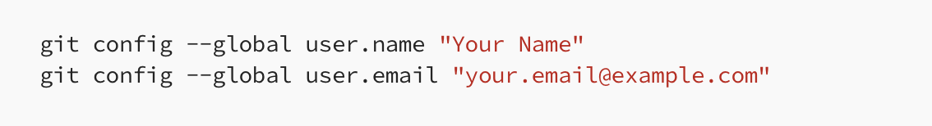
Git Setup: Telling Git Who You Are
Step 1: Configure Git
You’ll need to configure Git with your name and email address. This information will be used to identify your commits. To configure Git, open Terminal and type the following commands, replacing “Your Name” and “your.email@example.com” with your name and email address:
Lecture 3: Git for scientists
Bversity x Jagan L

Slide 23
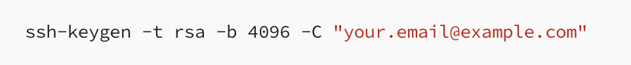
Step 2: Create a GitHub Account
If you don’t already have a GitHub account, you’ll need to create one. Go to the GitHub website and follow the instructions to sign up for an account.
Step 3: Generate SSH Key
Open Terminal and type the following command to generate a new SSH key:
Lecture 3: Git for scientists
Bversity x Jagan L

Slide 24
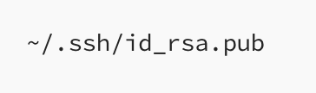
Step 4: Add SSH Key to
Now that you’ve generated an SSH key, you’ll need to add it to your GitHub account. Follow these steps: Copy the SSH key to your clipboard by running the following command in Terminal:
Go to the GitHub website, log in to your account, and navigate to “Settings” > “SSH and GPG keys.”
Click on “New SSH key,” paste your SSH key into the “Key” field, and give it a descriptive title.
Click “Add SSH key” to add your key to GitHub.
Lecture 3: Git for scientists
Bversity x Jagan L

Slide 25

Step 5: Verify SSH Key
To verify that your SSH key is set up correctly, run the following command in Terminal:
Lecture 3: Git for scientists
Bversity x Jagan L

Slide 26
git init and git clone: Creating Repositories
Git is a powerful tool for version control that helps you keep track of your project's development. To start using Git, you need to initialize a directory as a repository, which allows you to create and manipulate snapshots of your project's progress called commits. There are two ways to create a repository: by initializing a new one from an existing directory or by cloning an existing repository. Remember that Git only manages files and directories inside the repository directory, so keep all your project files there.
Let’s start by initializing the project directory:
$ git init
When you use git init, a magical .git/ directory is created in your project directory that Git uses to manage your repository. Remember not to touch anything in this directory, as it's for Git's eyes only. Cloning is another way to create a repository, where you can copy repositories from any location, including the internet through hosting services like GitHub and Bitbucket.
Lecture 3: Git for scientists
Bversity x Jagan L

Slide 27
Tracking Files in Git: git add and git status Part-1
After initializing the project directory as a Git repository, you need to explicitly tell Git which files to track using the "git add" command. This allows you to selectively track only the important files and ignore the rest, such as large data files or intermediate results. By doing this, Git avoids cluttering the repository with unnecessary files and makes it easier to manage changes in your project.
$ git add “files name”
Git status describes the current state of your project repository: what’s changed, what’s ready to be included in the next commit, and what’s not being tracked.
Lecture 3: Git for scientists
Bversity x Jagan L

Slide 28
git status tell us:
By default, Git starts on the "master" branch, which allows you to work on different versions of your project simultaneously. Git's branch feature is one of the primary reasons for its popularity as a version control system. At the moment, we only have the "master" branch in use, but we'll explore more branches later
Since we haven't instructed Git to track any files, we see all files listed as "untracked files" in the root project directory. This means that if we were to attempt a commit, there would be nothing to add.
Staging Files in Git: git add and git status Part II
With Git, there’s a difference between tracked files and files staged to be included in the next commit. A file that’s tracked means Git knows about it. A staged file is not only tracked, but its latest changes are staged to be included in the next commit.
A good way to illustrate the difference is to consider what happens when we change one of the files we started tracking with git add. Changes made to a tracked file will not automatically be included in the next commit. To include these new changes, we would need to explicitly stage them—using git add again.
Lecture 3: Git for scientists
Bversity x Jagan L

Slide 29
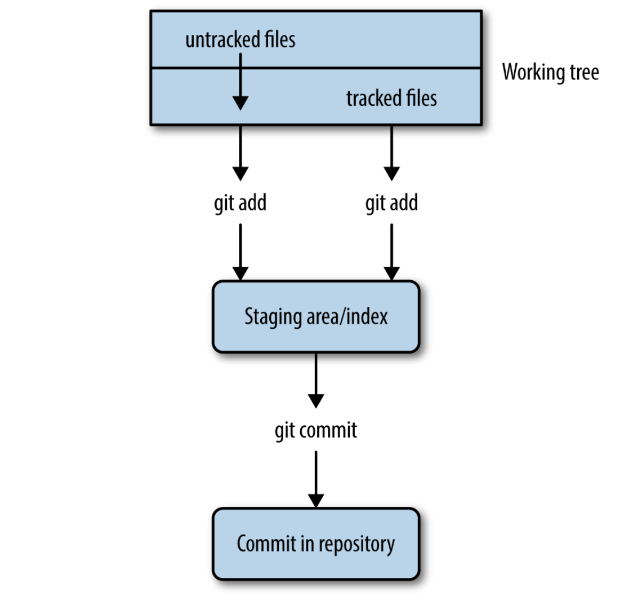
Git’s separation of the working tree (all files in your repository), the staging area (files to be included in the next commit), and committed changes (a snapshot of a version of your project at some point in time); git add on an untracked file begins track‐ ing it and stages it, while git add on a tracked file just stages it for the next commit
Lecture 3: Git for scientists
Bversity x Jagan L

Slide 30
Git Commit: Taking a Snapshot of Your Project
$ git commit -m "initial import"
This command commits your staged changes to your repository with the commit message “initial import.” Commit messages are notes to your collaborators (and your‐ self in the future) about what a particular commit includes.
Seeing File Differences: git diff
git diff shows you the difference between the files in your working directory and what’s been staged. If none of your changes have been staged, git diff shows us the difference between your last commit and the current versions of your files.
$ git diff
Lecture 3: Git for scientists
Bversity x Jagan L

Slide 31
Moving and Removing Files: git mv and git rm
When Git tracks your files, it wants to be in charge. Using the command mv to move a tracked file will confuse Git. The same applies when you remove a file with rm. To move or remove tracked files in Git, we need to use Git’s version of mv and rm: git mv and git rm.
Telling Git What to Ignore: .gitignore
You may have noticed that git status keeps listing which files are not tracked. As the number of files in your bioinformatics project starts to increase (this happens quickly!) this long list will become a burden.
Many of the items in this untracked list may be files we never want to commit. Sequencing data files are a great example: they’re usually much too large to include in a repository. If we were to commit these large files, collaborators cloning your repository would have to download these enormous data files. We’ll talk about other ways of managing these later, but for now, let’s just ignore them.
Lecture 3: Git for scientists
Bversity x Jagan L

Slide 32
What should we tell .gitignore to ignore?
In the context of a bioinformatics project, here are some guidelines:
Large files:
These should be ignored and managed by other means, as Git isn’t designed to manage really large files. Large files slow creating, pushing, and pulling commits. This can lead to quite a burden when collaborators clone your repository.
Intermediate files:
Bioinformatics projects are often filled with intermediate files. For example, if you align reads to a genome, this will create SAM or BAM files. Even if these aren’t large files, these should probably be ignored. If a data file can easily be reproduced by rerunning a command (or better yet, a script), it’s usually preferable to just store how it was created. Ultimately, recording and storing how you created an intermediate file in Git is more important than the actual file. This also ensures reproducibility.
Temporary code files
Some language interpreters (e.g., Python) produce temporary files (usually with some sort of optimized code). With Python, these look like overlap.pyc.
Lecture 3: Git for scientists
Bversity x Jagan L

Slide 33
Seeing Your Commit History: git log
We can use git log to visualise our chain of commits:
$ git log
Undoing a Stage: git reset
Recall that one nice feature of Git is that you don’t have to include messy changes in a commit—just don’t stage these files. If you accidentally stage a messy file for a commit with git add, you can unstage it with git reset.
$ git reset HEAD “filename”
Lecture 3: Git for scientists
Bversity x Jagan L

Slide 34
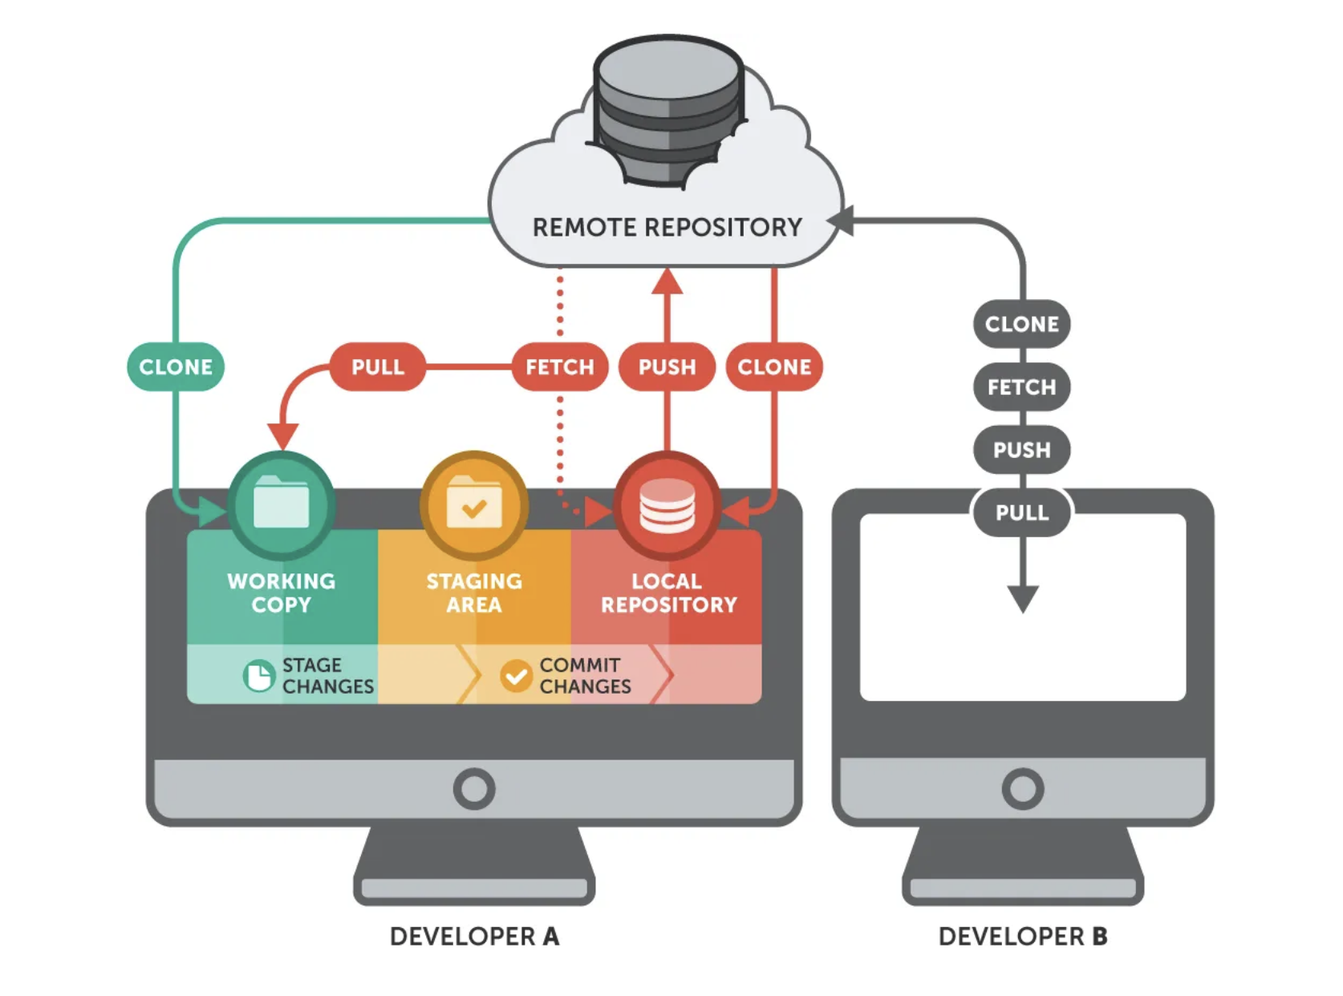
Collaborating with Git: Git Remotes, git push, and git pull
Lecture 3: Git for scientists
Bversity x Jagan L

Slide 35
Creating a Shared Central Repository with GitHub
Navigate to http://github.com and sign up for an account.
On the main page, there’s a link to create a new repository. After you’ve navigated to the Create a New Repository page, you’ll see you need to provide a repository name, and you’ll have the choice to initialize with a README.md file (GitHub plays well with Markdown), a .gitignore file, and a license (to license your software project).
For now, just create a repository named project-test. After you’ve clicked the “Create repository” button, GitHub will forward you to an empty repository page—the public frontend of your project.
Connecting with Git Remotes: git remote
Now, let’s configure our local repository to use the GitHub repository we’ve just created as a remote repository.
$ git remote add origin git@github.com:username/project-test.git
Lecture 3: Git for scientists
Bversity x Jagan L

Slide 36
Pushing Commits to a Remote Repository with git push
With our remotes added, we’re ready to share our work by pushing our commits to a remote repository. Collaboration on Git is characterized by repeatedly pushing your work to allow your collaborators to see and work on it, and pulling their changes into your own local repository. As you start collaborating, remember you only share the commits you’ve made.
Let’s push our initial commits from project-test into our remote repository on GitHub.
$ git push <remote-name> <branch>
Lecture 3: Git for scientists
Bversity x Jagan L

Slide 37
Pulling Commits from a Remote Repository with git pull
As you push new commits to the central repository, your collaborator’s repository will go out of date, as there are commits on the shared repository she doesn’t have in her own local repository. She’ll need to pull these commits in before continuing with her work. Collaboration on Git is a back-and-forth exchange, where one person pushes their latest commits to the remote repository, other collaborators pull changes into their local repositories, make their own changes and commits, and then push these commits to the central repository for others to see and work with
$ git pull <remote-name> <branch>
Lecture 3: Git for scientists
Bversity x Jagan L

Slide 38
Bioinformatics Data skills
Lecture 4: Bioinformatics Data Skills
Bversity x Jagan L

Slide 39
Inspecting Data with Head and Tail
Many files we encounter in bioinformatics are much too long to inspect with cat— running cat on a file a million lines long would quickly fill your shell with text scrolling far too fast to make sense of. A better option is to take a look at the top of a file with head.
$ head File_name
We can also control how many lines we see with head through the -n argument:
$ head -n 3 File_name
head is useful for a quick inspection of files. head -n 3 allows you to quickly inspect a file to see if a column header exists, how many columns there are, what delimiter is being used, some sample rows, and so on.
Lecture 4: Bioinformatics Data Skills
Bversity x Jagan L

Slide 40
Sometimes it’s useful to see both the beginning and end of a file—for example, if we have a sorted BED file and we want to see the positions of the first feature and last feature.
$ (head -n 2; tail -n 2) < File_name
less
less is also a useful program for a inspecting files and the output of pipes. less is a terminal pager, a program that allows us to view large amounts of text in our terminals. Normally, if we cat a long file to screen, the text flashes by in an instant—less allows us to view and scroll through long files and standard output a screen at a time. Other applications can call the default terminal pager to handle displaying large amounts of output; this is how git log displays an entire Git repository’s commit history. You might run across another common, but older terminal pager called more, but less has more features and is generally preferred (the name of less is a play on “less is more”).
$ less File_name
Lecture 4: Bioinformatics Data Skills

Slide 41
Plain-Text Data Summary Information with wc, ls
In addition to peeking at a file with head, tail, or less, we may want other bits of summary information about a plain-text data file like the number of rows or columns. With plain-text data formats like tab-delimited and CSV files, the number of rows is usually the number of lines. We can retrieve this with the program wc (for word count):
$ wc File_name
By default, wc outputs the number of words, lines, and characters of the supplied file.
Often, we only care about the number of lines. We can use option -l to just return the number of lines:
$ wc -l File_name

Slide 42
Working with Column Data with cut and Columns
When working with plain-text tabular data formats like tab-delimited and CSV files, we often need to extract specific columns from the original file or stream. For example, suppose we wanted to extract only the start positions (the second column) of the Mus_musculus.GRCm38.75_chr1.bed file. The simplest way to do this is with cut. This program cuts out specified columns (also known as fields) from a text file. By default, cut treats tabs as the delimiters, so to extract the second column we use:
$ cut -f 2 Mus_musculus.GRCm38.75_chr1.bed | head -n 3
The -f argument is how we specify which columns to keep. The argument -f also allows us to specify ranges of columns (e.g., -f 3-8) and sets of columns (e.g., -f 3,5,8). Note that it’s not possible to reorder columns using using cut (e.g., -f 6,5,4,3 will not work, unfortunately).

Slide 43
Using cut, we can convert our GTF for Mus_musculus.GRCm38.75_chr1.gtf to a three-column tab-delimited file of genomic ranges (e.g., chromosome, start, and end position). We’ll chop off the metadata rows using the grep command covered earlier, and then use cut to extract the first, fourth, and fifth columns (chromosome, start, end):
$ grep -v "^#" Mus_musculus.GRCm38.75_chr1.gtf | cut -f1,4,5 | head -n 3
Formatting Tabular Data with column
As you may have noticed when working with tab-delimited files, it’s not always easy to see which elements belong to a particular column. There’s a fix for this in Unix: program column -t (the -t option tells column to treat data as a table). column -t produces neat columns that are much easier to read:
$ grep -v "^#" Mus_musculus.GRCm38.75_chr1.gtf | cut -f 1-8 | column -t
Note that you should only use columnt -t to visualize data in the terminal, not to reformat data to write to a file.

Slide 44
Like cut, column’s default delimiter is the tab character (\t). We can specify a differ‐ ent delimiter with the -s option. So, if we wanted to visualize the columns of the Mus_musculus.GRCm38.75_chr1_bed.csv file more easily, we could use:
$ column -s"," -t Mus_musculus.GRCm38.75_chr1_bed.csv | head -n 3
column illustrates an important point about how we should treat data: there’s no reason to make data formats attractive at the expense of readable by programs. Single character delimited columns (like CSV or tab delimited) can be difficult for humans to read, consider the following points:
• They work instantly with nearly all Unix tools. • They are easy to convert to a readable format with column -t.
In general, it’s easier to make computer-readable data attractive to humans than it is to make data in a human-friendly format readable to a computer. Unfortunately, data in formats that prioritize human readability over computer readability still linger in bioinformatics.

Slide 45
Sorting Plain-Text Data with Sort
First, like cut, sort is designed to work with plain-text data with columns. Running sort without any arguments simply sorts a file alphanumerically by line:
$ sort example.bed
However, using sort’s defaults of sorting alphanumerically by line doesn’t handle tabular data properly. There are two new features we need:
• The ability to sort by particular columns
• The ability to tell sort that certain columns are numeric values
sort has a simple syntax to do this. Let’s look at how we’d sort example.bed by chro‐ mosome (first column), and start position (second column):
$ sort -k1,1 -k2,2n example.bed
Here, we specify the columns (and their order) we want to sort by as -k arguments. In technical terms, -k specifies the sorting keys and their order. Each -k argument takes a range of columns as start,end, so to sort by a single column we use start,start.

Slide 46
In the preceding example, we first sorted by the first column (chromosome), as the first -k argument was -k1,1. Sorting by the first column alone leads to many ties in rows with the same chromosomes (e.g., “chr1” and “chr3”). Adding a second -k argument with a different column tells sort how to break these ties. In our example, -k2,2n tells sort to sort by the second column (start position), treating this column as numerical data (because there’s an n in -k2,2n).
Finding Unique Values in Uniq
Unix’s uniq takes lines from a file or standard input stream, and outputs all lines with consecutive duplicates removed. While this is a relatively simple functionality, you will use uniq very frequently in command-line data processing.
$ sort letters.txt | uniq
uniq also has a tremendously useful option that’s used very often in command-line data processing: -c. This option shows the counts of occurrences next to the unique lines.
$ sort letters.txt | uniq -c

